Slide 1



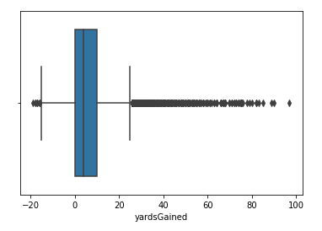
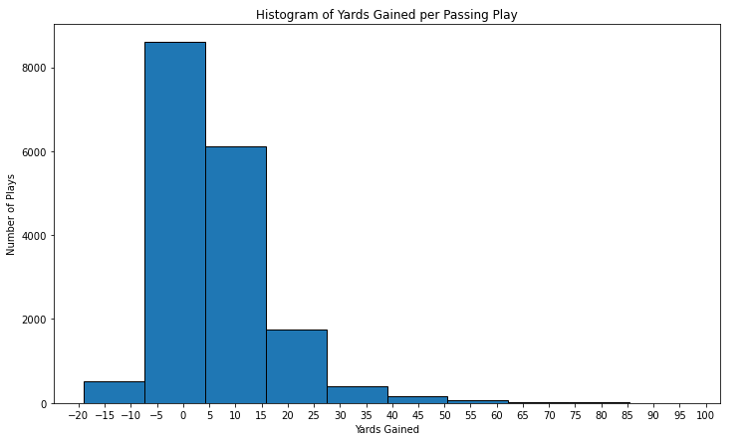
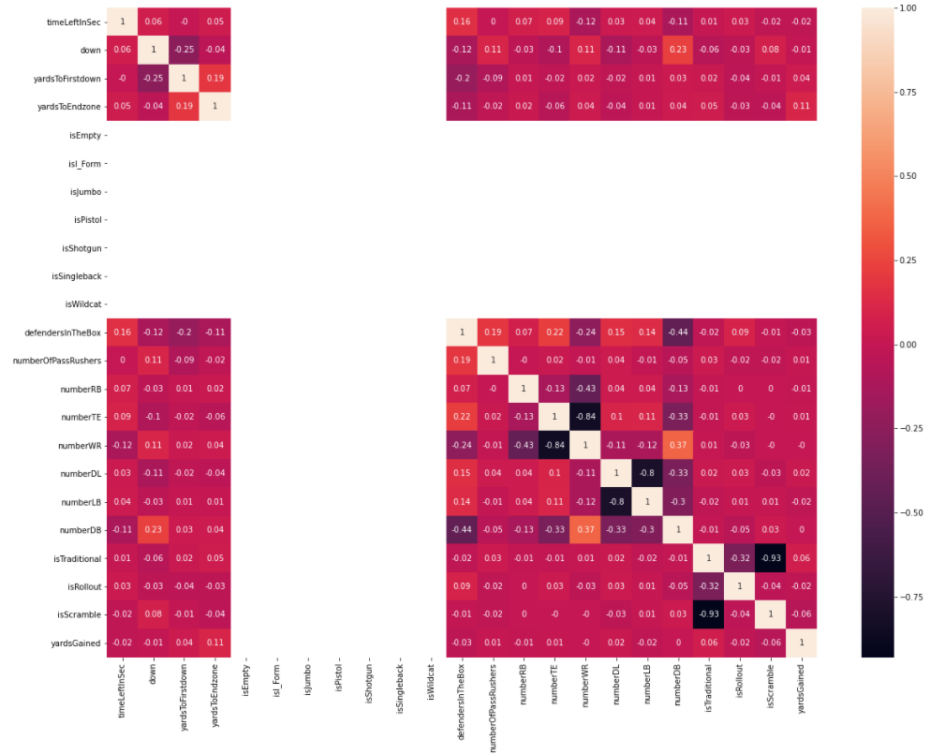
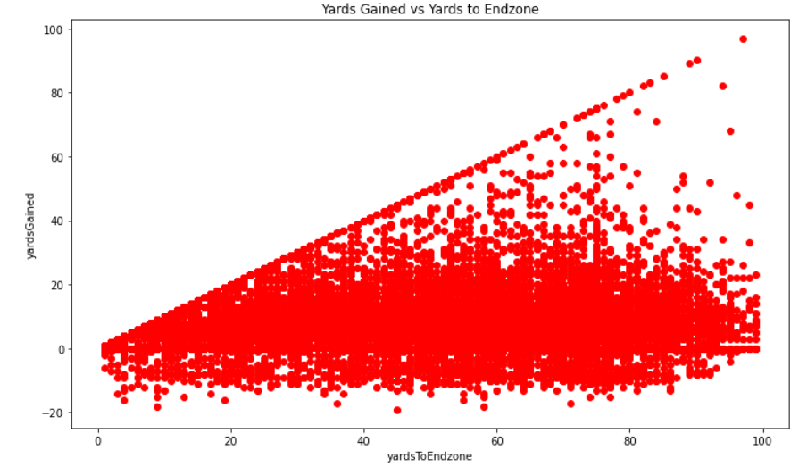
Analysis
All Data:
Polynomial Regression:
Narrowing the Data
- After unsuccessful regression, we tried several filters, including removing yard outliers, looking at only plays with yards from -5 to +10, and plays of specific formations
- Correlation improvements were minor
NFL Passing Plays
Treyten, Haley, Quenton
Data: (kaggle.com/c/nfl-big-data-bowl-2021/data)
Original: 19,240 R x 27 C
Post-Cleaning: 17,662 R x 25 C
Data was from the 2018 regular season and contained only passing plays
- Predictors: timeLeftInSec, down, yardsToFirstdown, yardsToEndzone, formation, playType, and position quantities for both offense and defense
- Classifier: yardsGained
Conclusion
Passing plays in the NFL may not be predictable.
Hypothesis: Plays cannot be predicted because of the nature of the competitiveness of the NFL. We think that if the success of a play could be predicted, coaches from both teams would use this knowledge and the prediction ability would become meaningless.

